Slide 1

CSE3151
Computer Networks
(Session 2018-19)
Dr. Asif Zaman
Associate Professor, CSE, RU

Slide 2
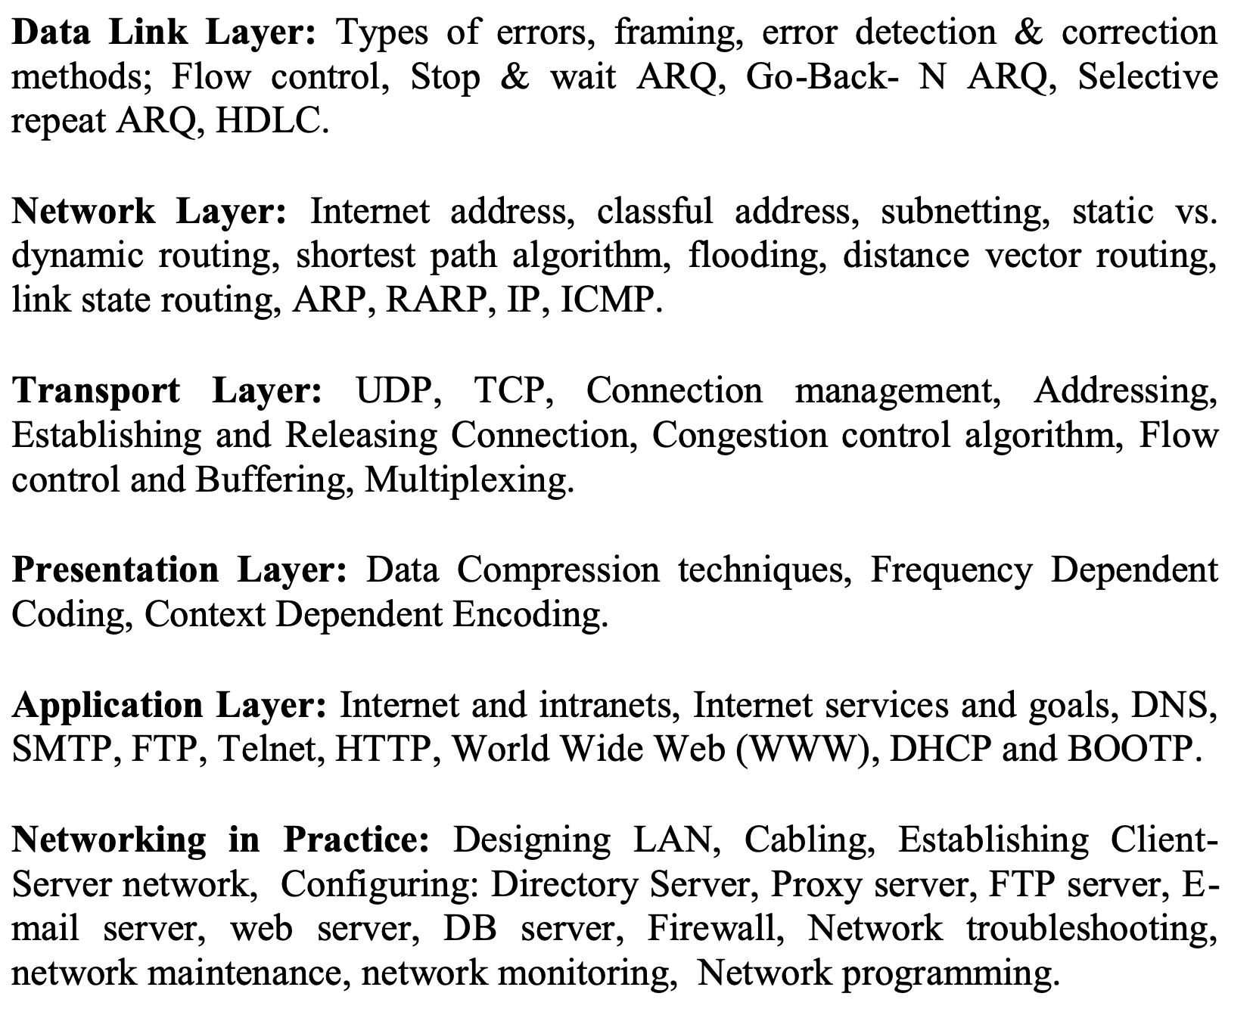
Data Link Layer

Slide 3
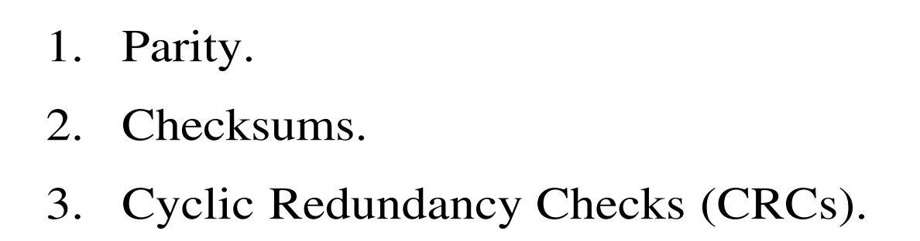
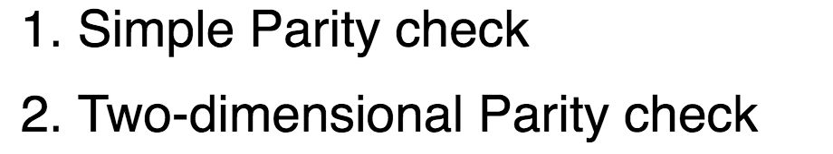
Error Detection
Error Detection

Slide 4
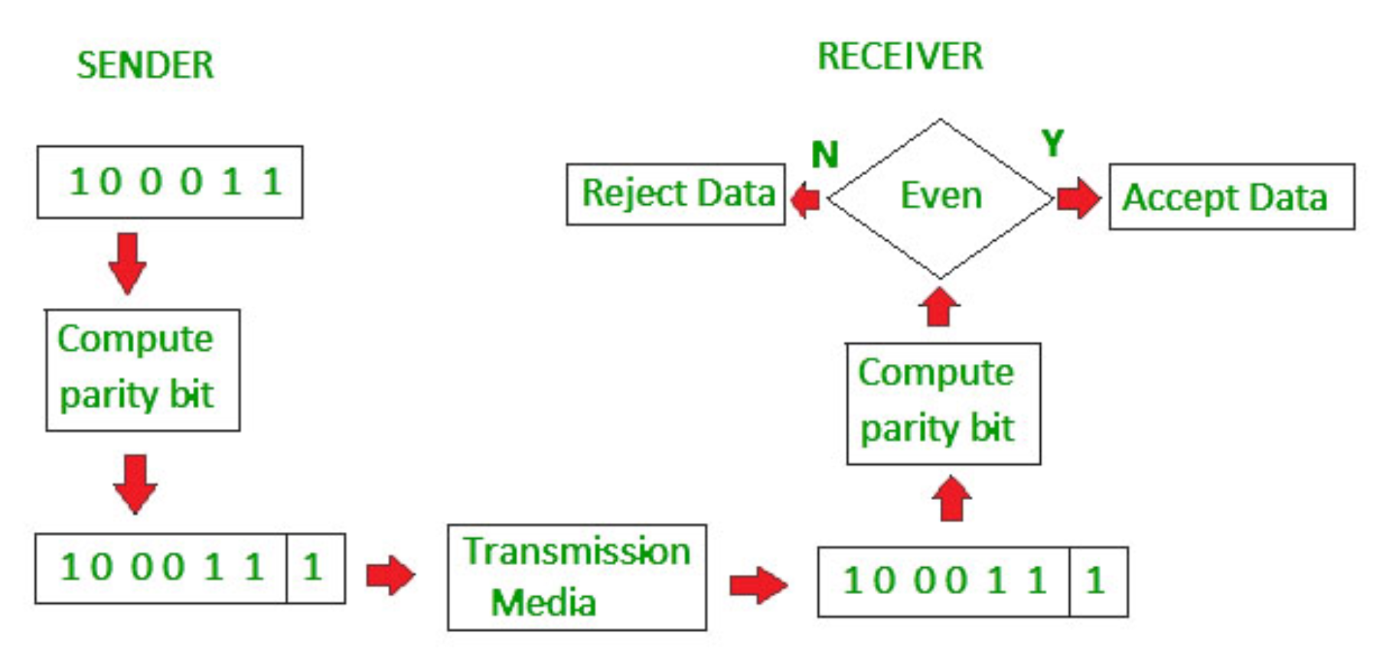
Error Detection
Simple Parity Check

Slide 5
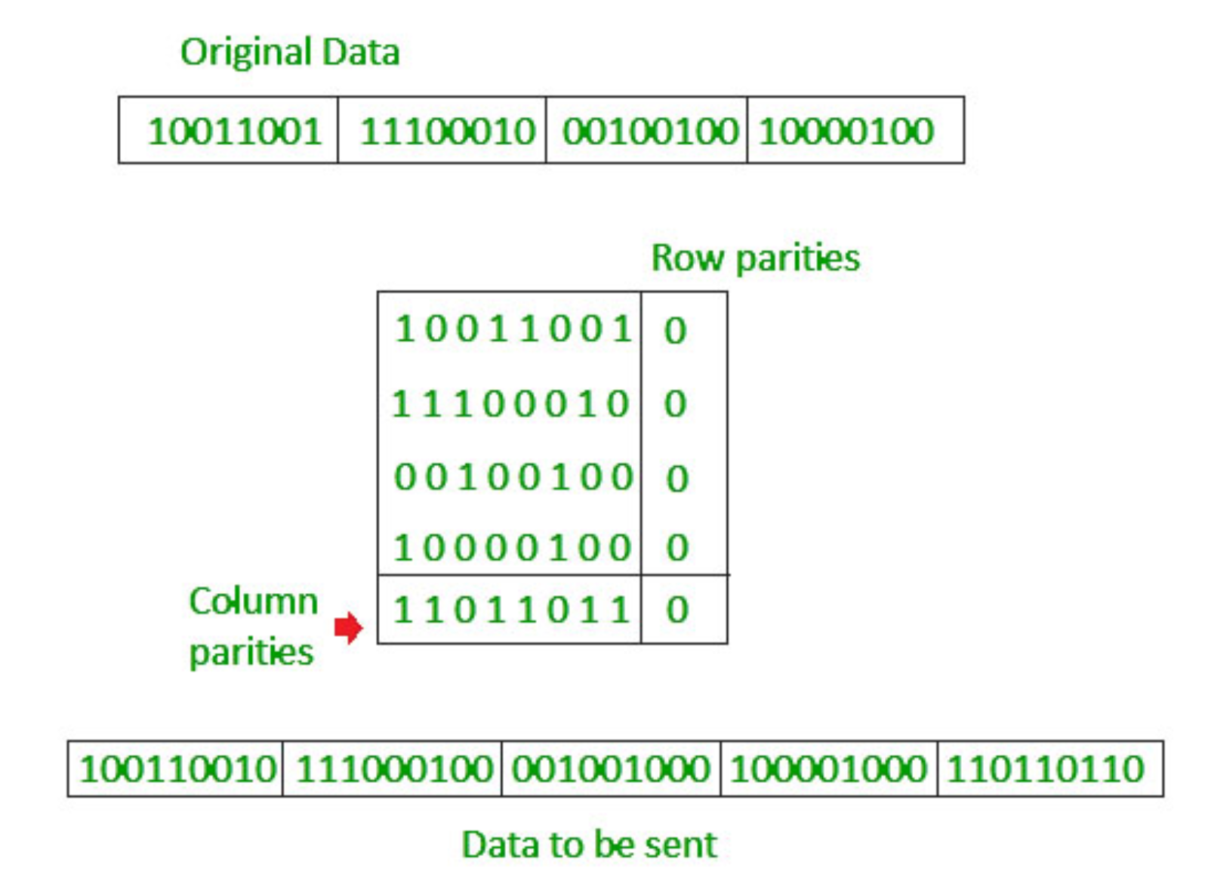
Error Detection
Two Dimensional Parity Check

Slide 6
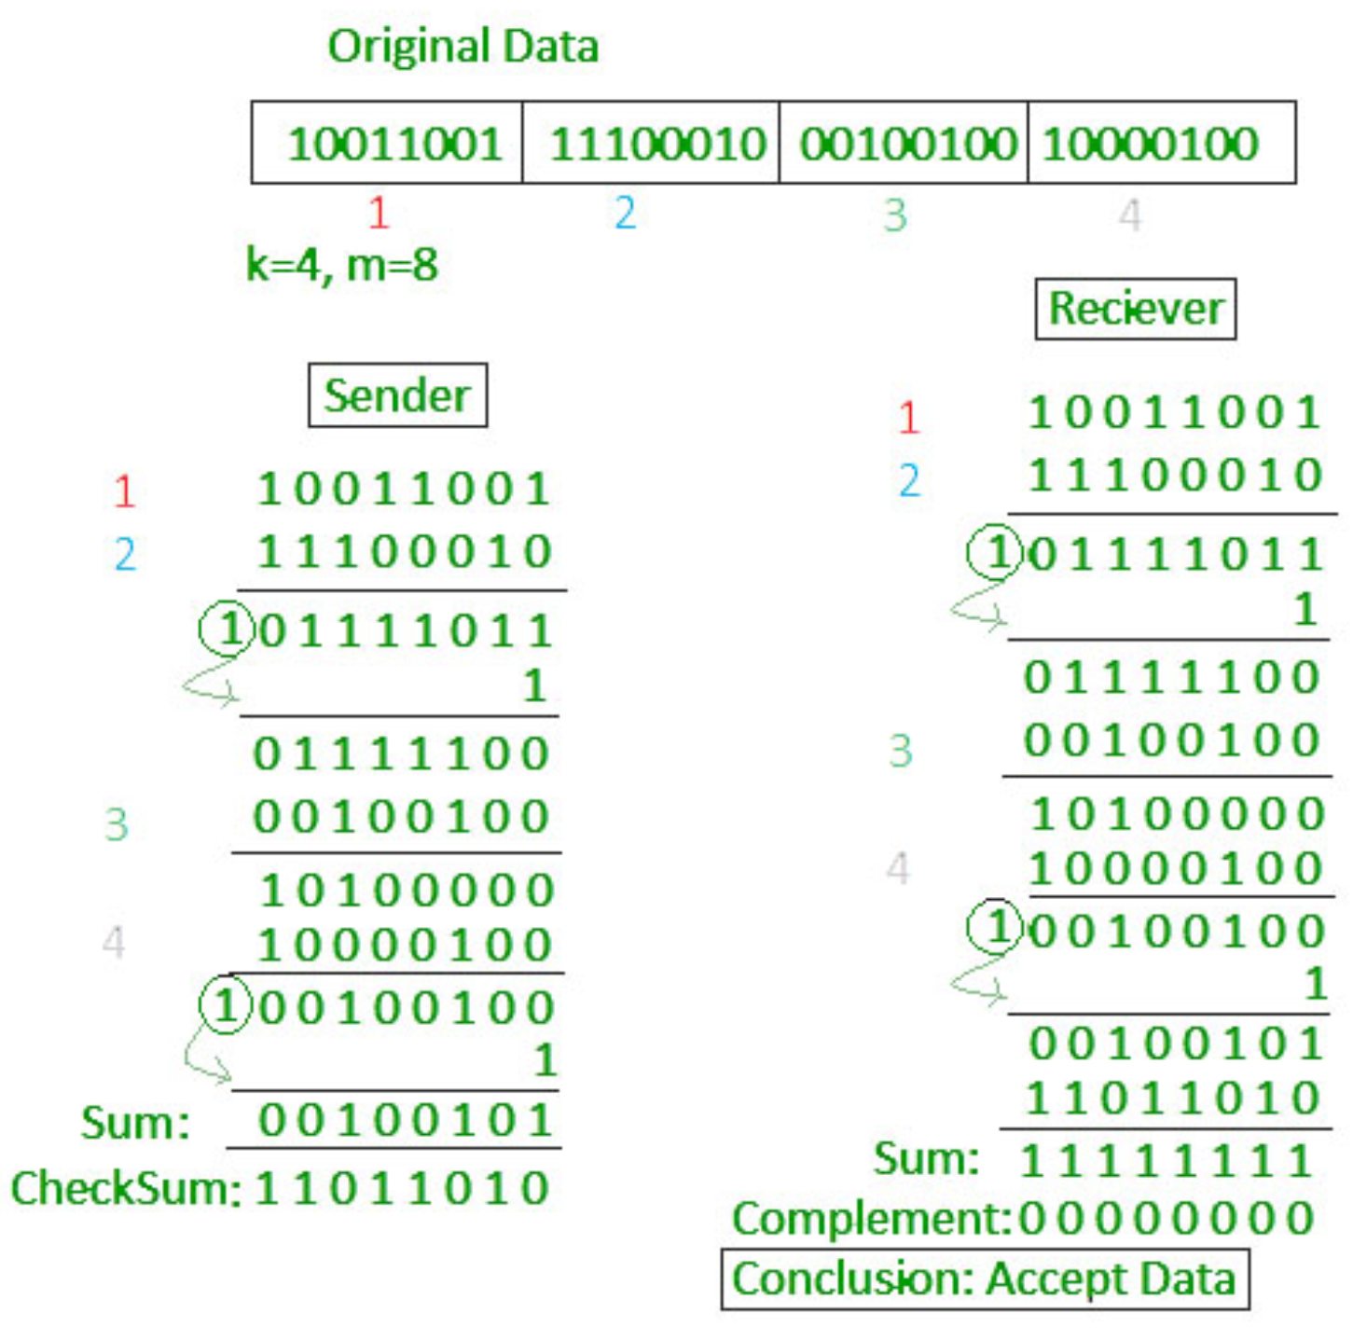
Error Detection
Checksum:
https://www.geeksforgeeks.org/error-detection-in-computer-networks/

Slide 7
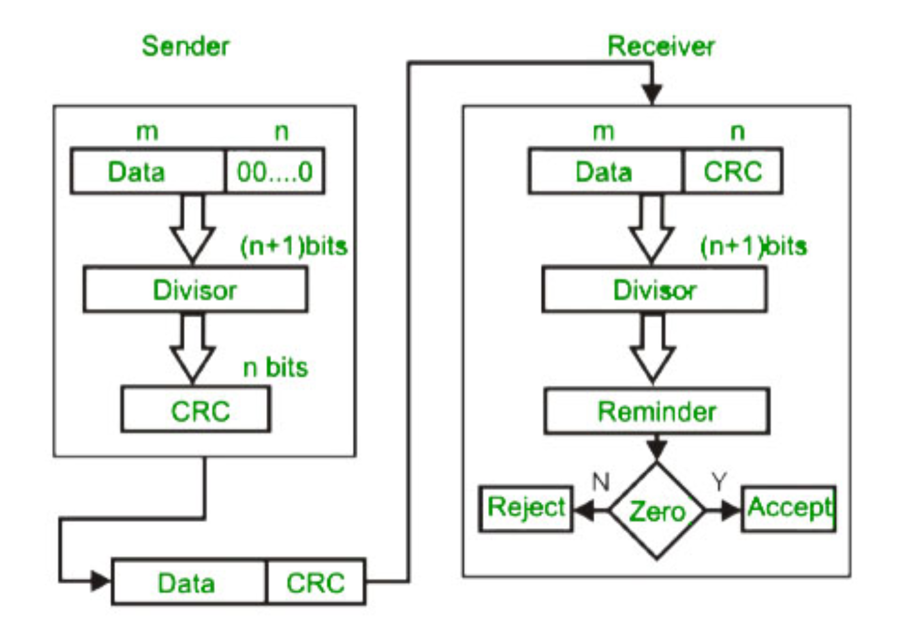
Error Detection
CRC (cyclic redundancy check):
https://www.geeksforgeeks.org/error-detection-in-computer-networks/

Slide 8
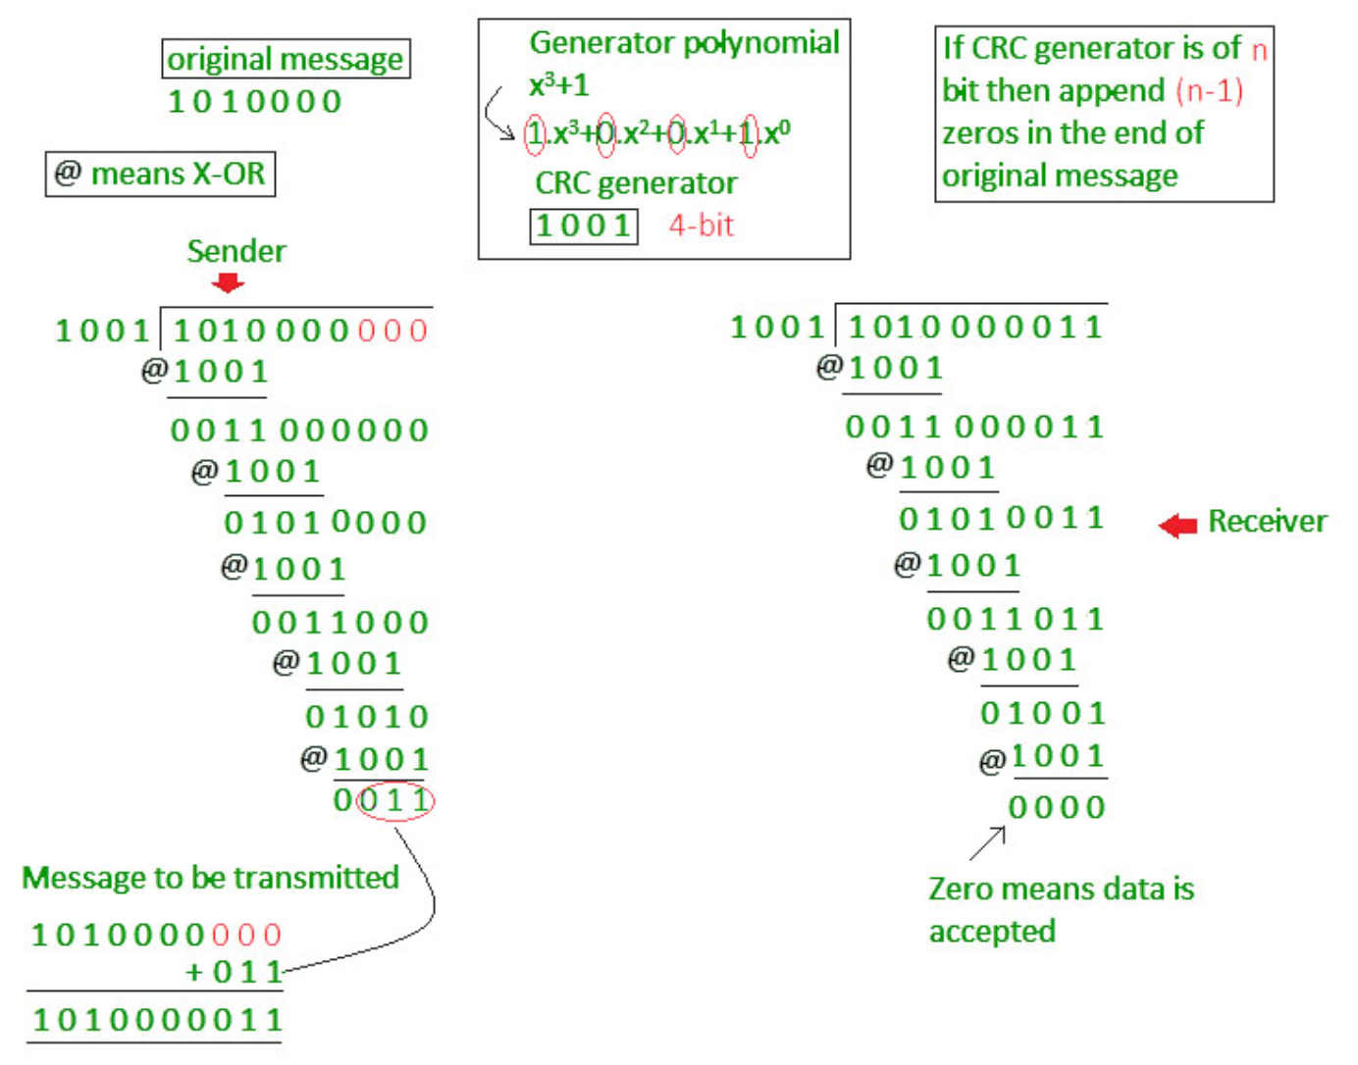

Slide 9

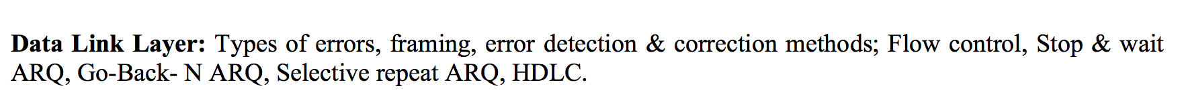
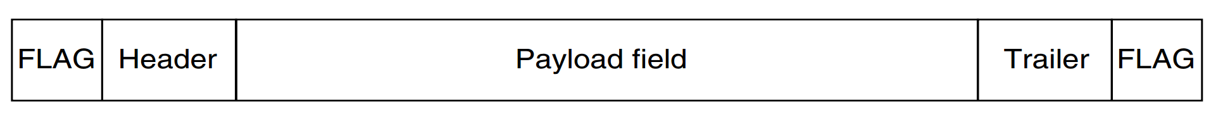
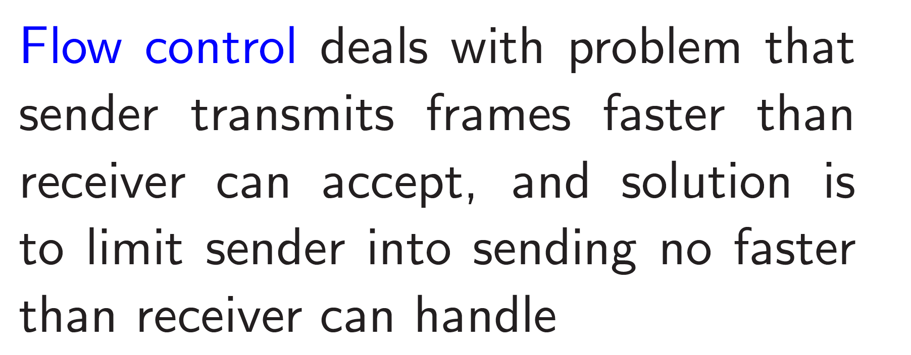
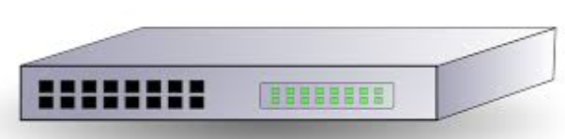
Data Link Layer
Frame –
Flag –
Error Detection and Correction….

Slide 10
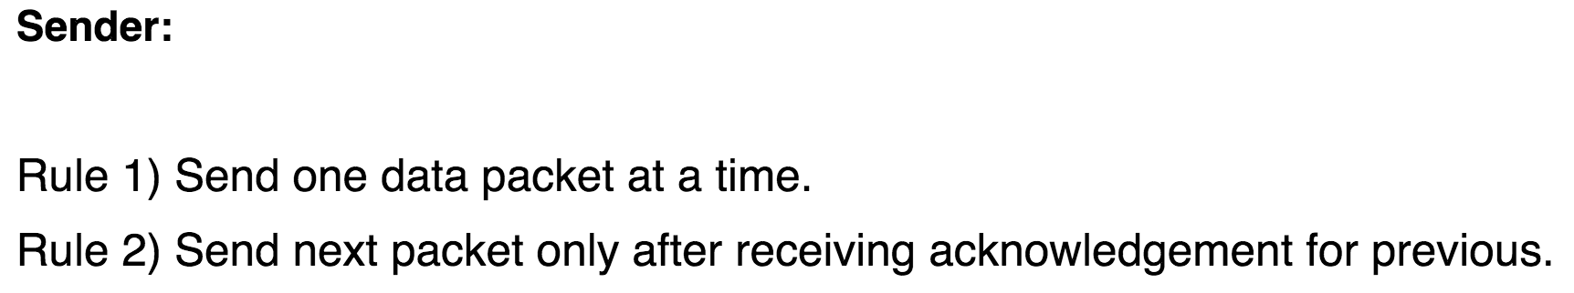
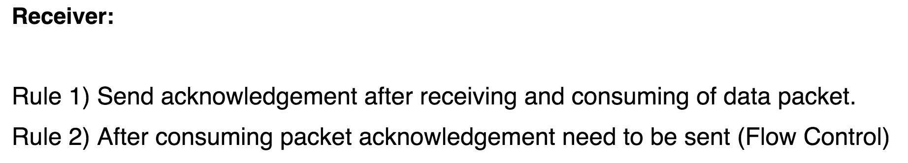
Simple Stop and Wait
Simple Stop and Wait

Slide 11
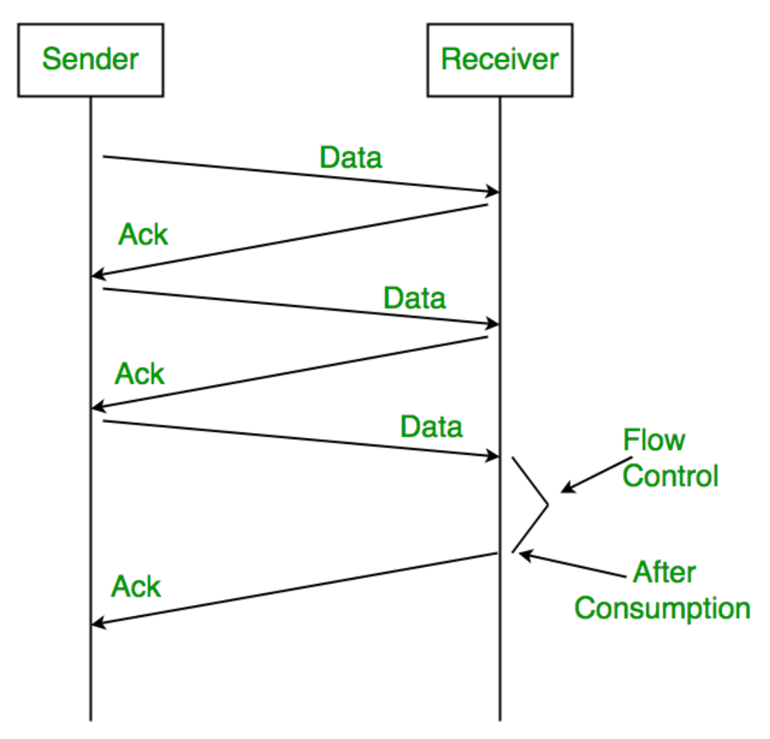
Simple Stop and Wait
Ack/Nak

Slide 12
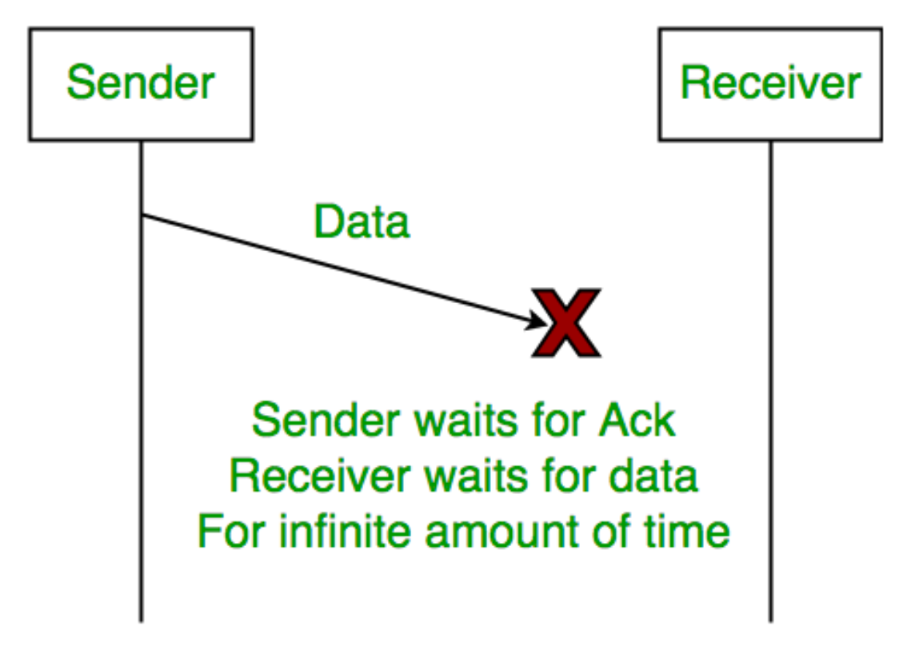
Simple Stop and Wait

Slide 13
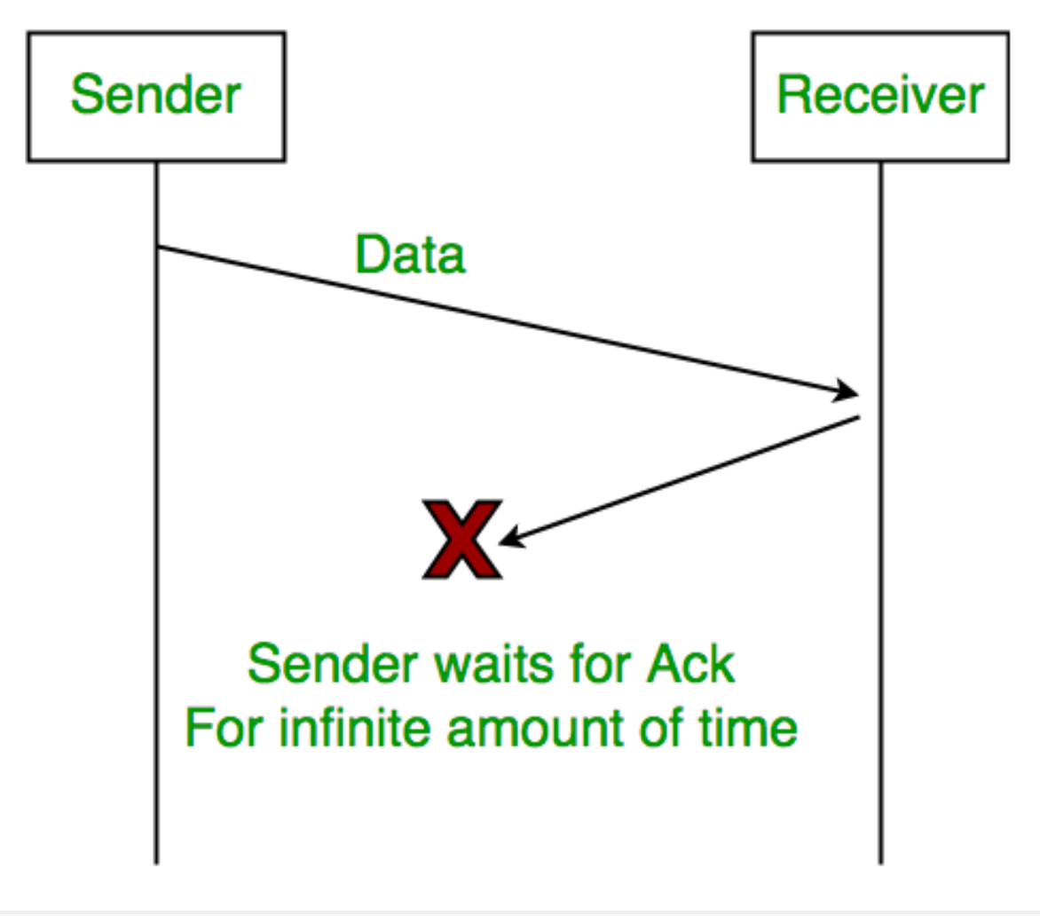
Simple Stop and Wait
Delayed Acknowledgement/Data: After timeout on sender side, a long delayed acknowledgement might be wrongly considered as acknowledgement of some other recent packet.

Slide 14
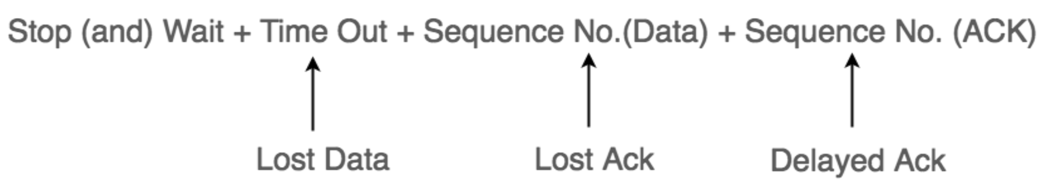
Stop and Wait ARQ
… 3 problems are resolved by Stop and Wait ARQ (Automatic Repeat Request) that does both error control and flow control.
ARQ : Automatic Repeat Request

Slide 15
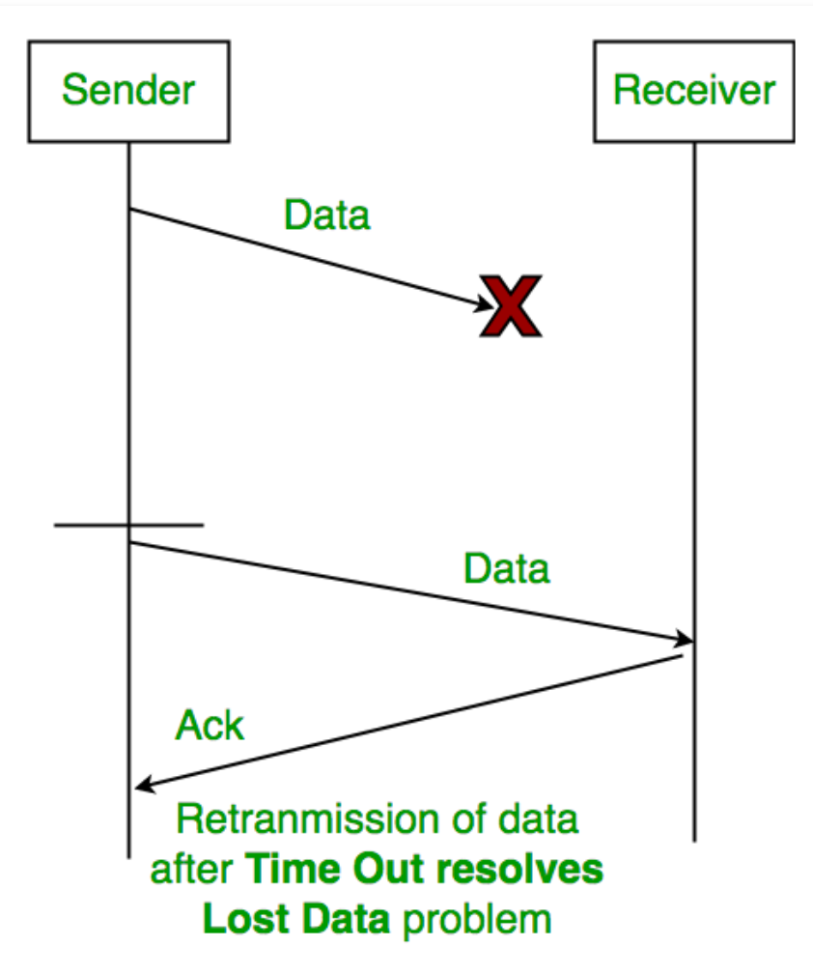
Stop and Wait ARQ

Slide 16
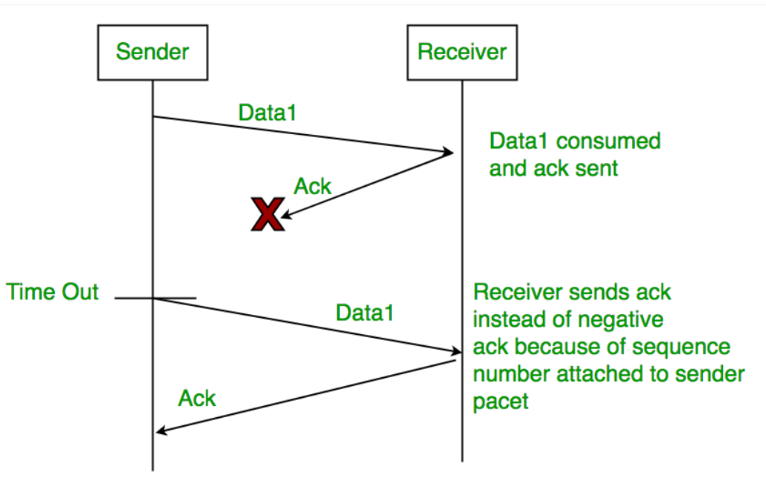
Stop and Wait ARQ

Slide 17
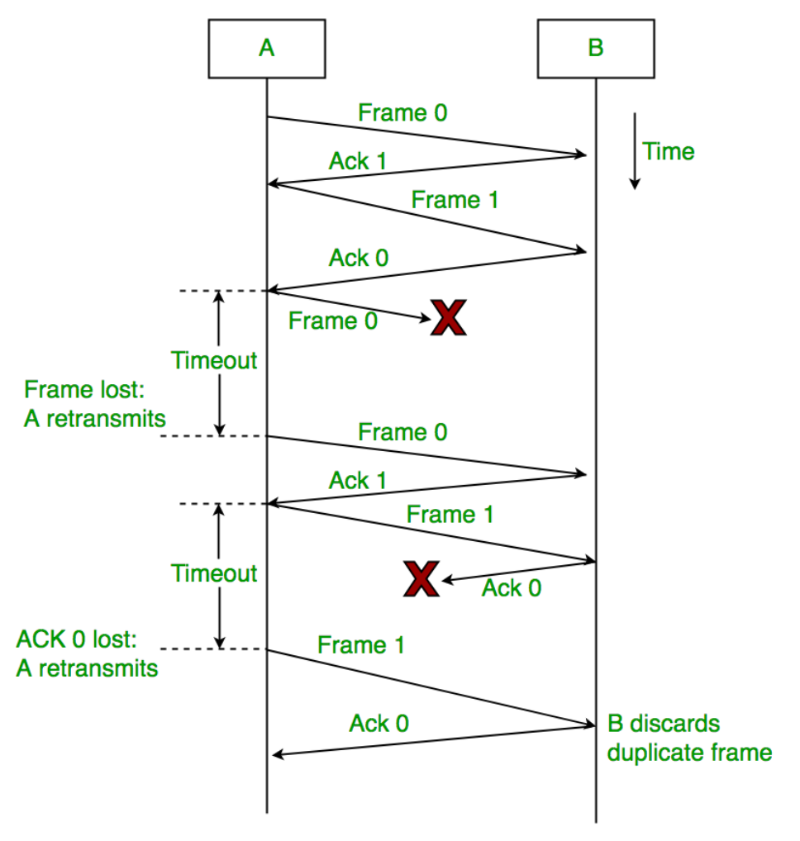
Stop and Wait ARQ
Sender A sends a data frame or packet with sequence number 0.
Receiver B, after receiving data frame, sends and acknowledgement with sequence number 1 (sequence number of next expected data frame or packet)

Slide 18
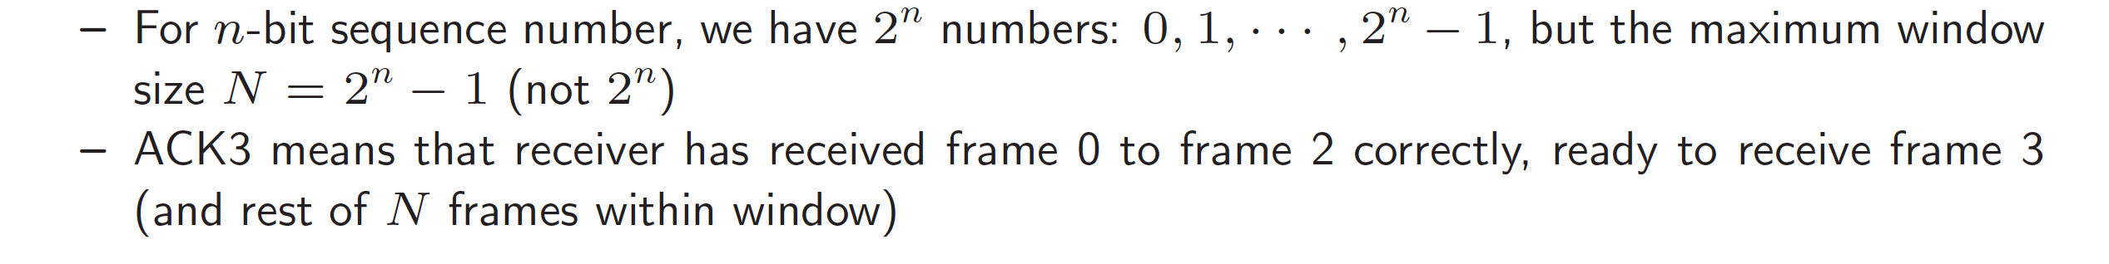
Sliding Window ARQ
Frames and acknowledgements are numbered using Sequence Numbers
Sender maintains a list of sequence numbers (frames) it is allowed to transmit, called Sending Window.
Receiver maintains a list of sequence numbers it is prepared to receive, called Receiving Window.
A sending window of size N means that sender can send up to N frames without the need for an ACK.
A window size of N implies buffer space for N frames.

Slide 19
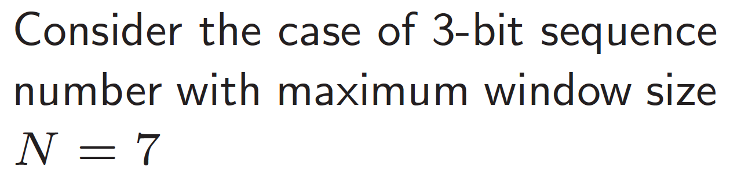
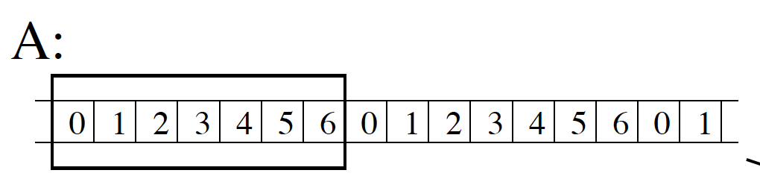
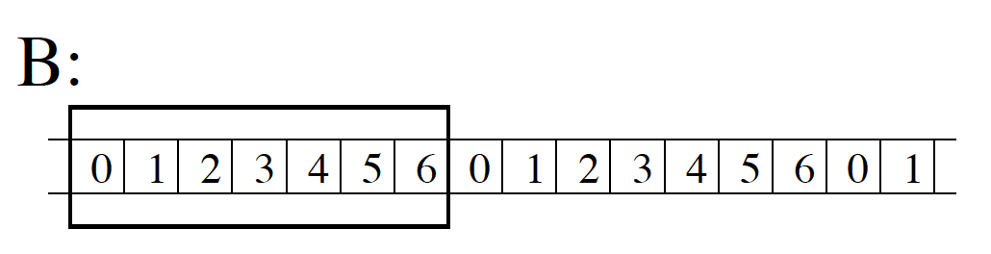
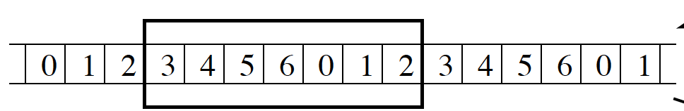
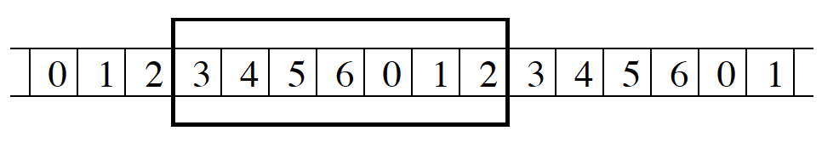
Sliding Window ARQ
ACK3

Slide 20
Sliding Window ARQ
Sliding Window ARQ
Go back N arq
Selective Reject arq

Slide 21
Sliding Window ARQ
Go back N arq
Selective Reject arq

Slide 22
HDLC
HDLC: High-level Data Link Control (HDLC)
High-level Data Link Control (HDLC) is a group of communication protocols of the data link layer for transmitting data between network points or nodes.
Since it is a data link protocol,
data is organized into frames.
A frame is transmitted via the network to the destination that verifies its successful arrival.
It is a bit - oriented protocol that is applicable for both point - to - point and multipoint communications.

Slide 23
HDLC-Transfer Modes
Normal Response Mode (NRM)
Asynchronous Balanced Mode (ABM)
Normal Response Mode (NRM) − two types of stations are there,
a primary station that send commands and
secondary station that can respond to received commands.
It is used for both point - to - point and multipoint communications.

Slide 24
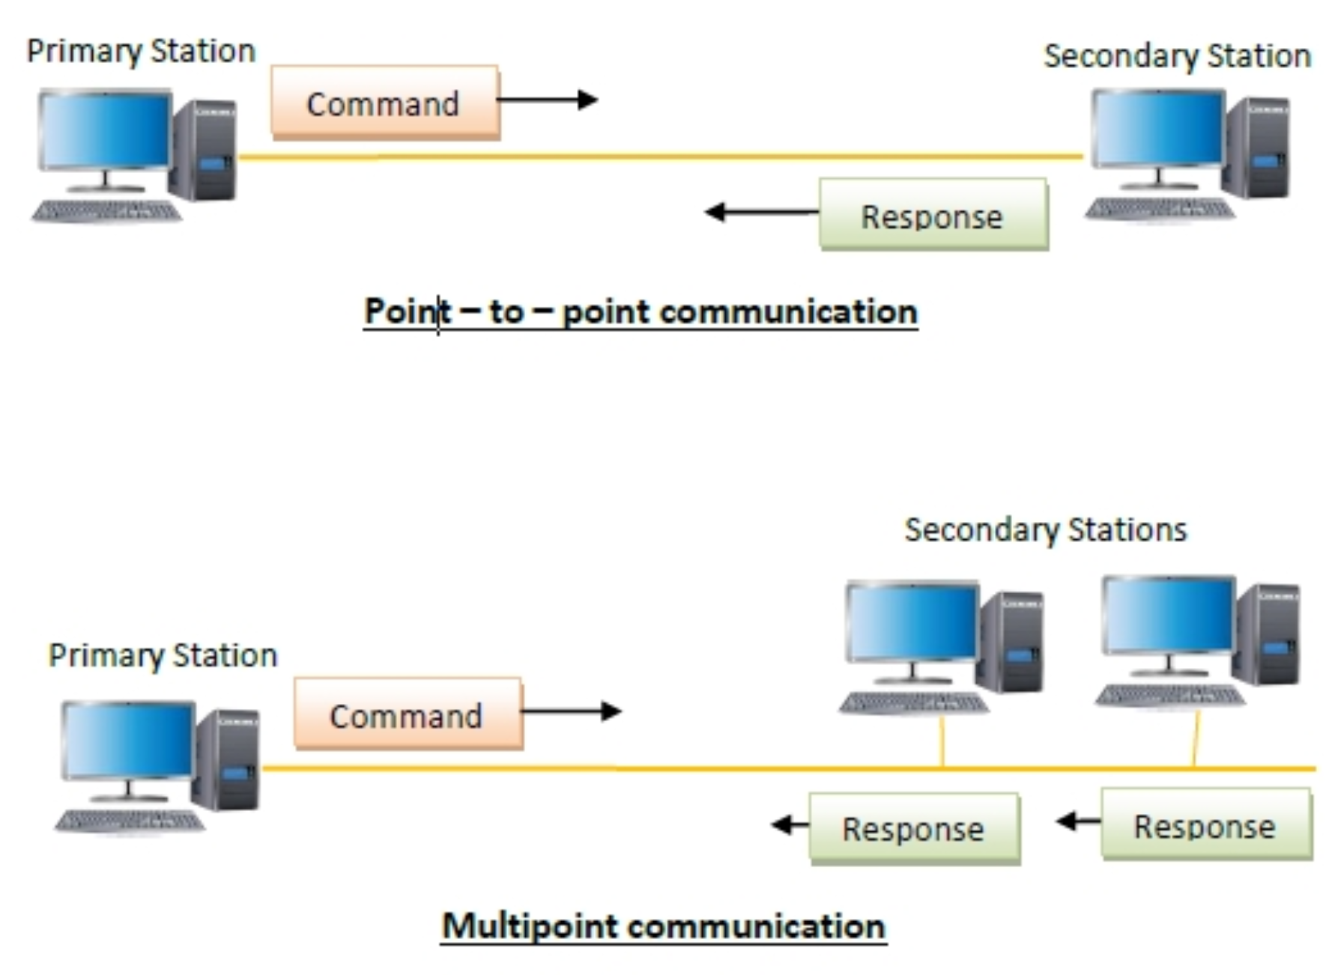
HDLC-Transfer Modes-NRM

Slide 25
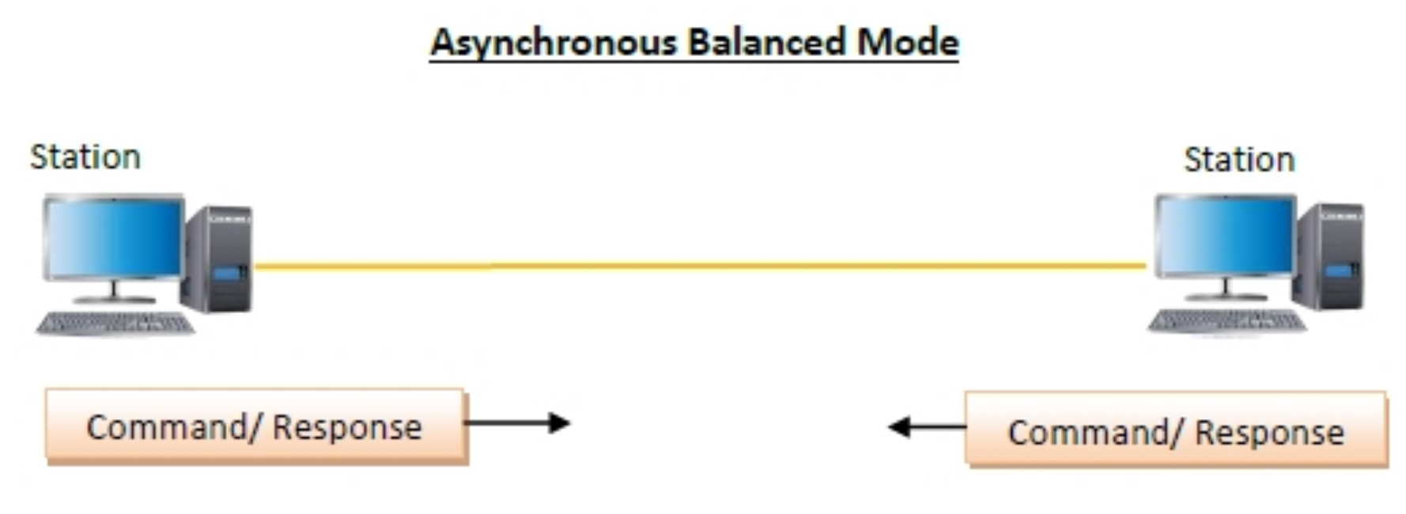
HDLC-Transfer Modes-ABM
Asynchronous Balanced Mode (ABM)
the configuration is balanced, i.e. each station can both send commands and respond to commands. It is used for only point - to - point communications.

Slide 26
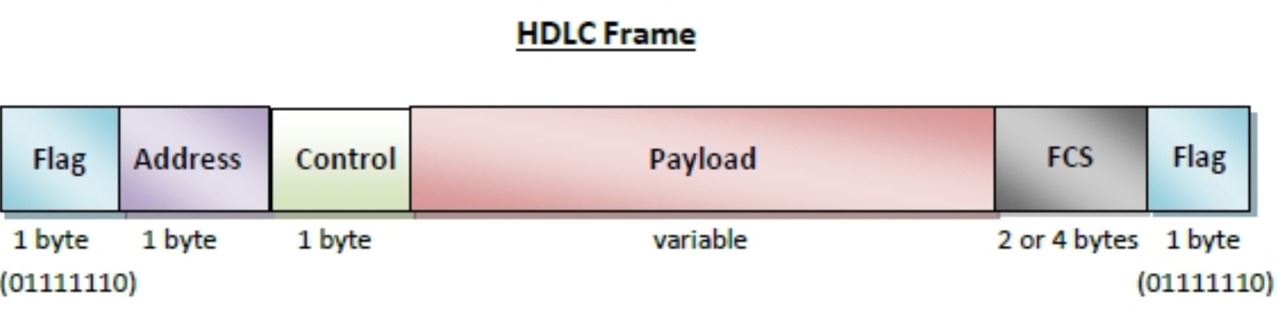
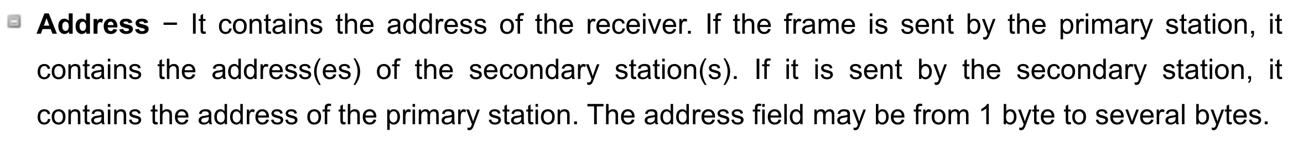
HDLC Frame
HDLC frame contains up to six fields

Slide 28
Types of HDLC Frames
There are three types of HDLC frames.
I- frame
S- frame
U- frame

Slide 29
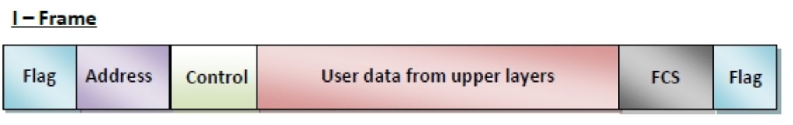
I-frame −
I-frames or Information frames carry user data from the network layer.
They also include flow and error control information that is piggybacked on user data.
The first bit of control field of I-frame is 0.

Slide 30
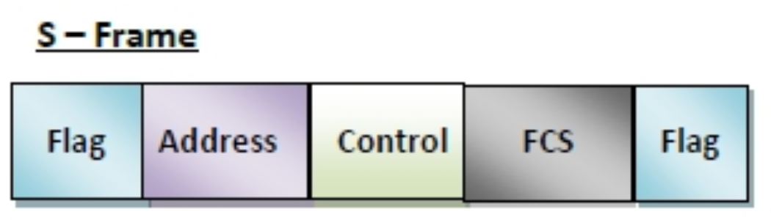
S-frame −
S-frames or Supervisory frames do not contain information field.
They are used for flow and error control ….
The first two bits of control field of S-frame is 10.

Slide 31
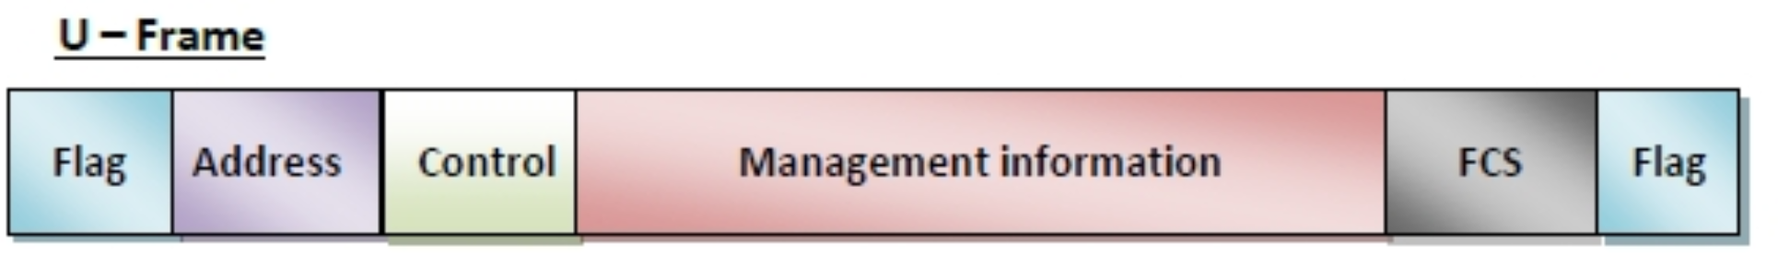
U-frame −
U-frames or Un-numbered frames are used for myriad miscellaneous functions, like link management.
It may contain an information field, if required.
The first two bits of control field of U-frame is 11.
https://www.tutorialspoint.com/high-level-data-link-control-hdlc

Slide 32
